Slide 1

VPSRG ANUS Data Collection
This script is designed to save everything into a folder it automagically creates on the local hard drive:
C:\temp\[Hospital Id]\[Patient id]
Please zip this folder and upload it to the following Google drive folder:
https://drive.google.com/drive/folders/1aagv9ObEUAqSC6XxKZIKhwJ2_wzOGFbj?usp=sharing
Those with a google account can sign in to the google drive and upload the zipped folder.
Those without a google account can sign-in using VPSRPG (password R....P... the thing we use for predicting DVHs)
Please, create a folder for your Hospital [Hospital Id] and put all your patients there.
You can also automatically import the data into the accompanying Excel spreadsheet for your own analysis (if you so wish)
ALCC – Flavio Nelli & Phillip Moloney

Slide 2
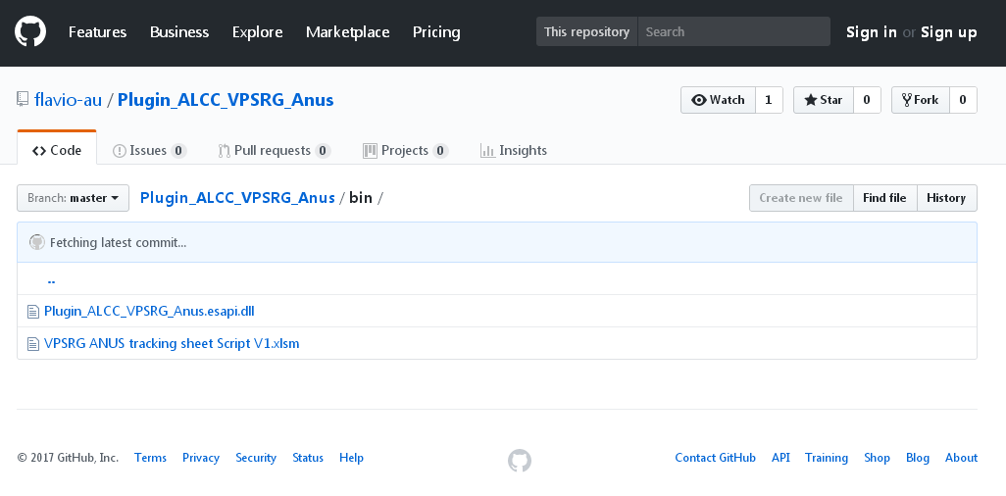
Download files from Github.com
Download the Eclipse data export script and excel spreadsheet from github
https://github.com/flavio-au/Plugin_ALCC_VPSRG_Anus/tree/master/bin
ALCC – Flavio Nelli & Phillip Moloney

Slide 3
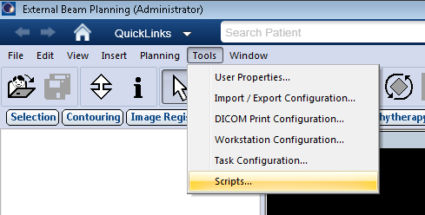
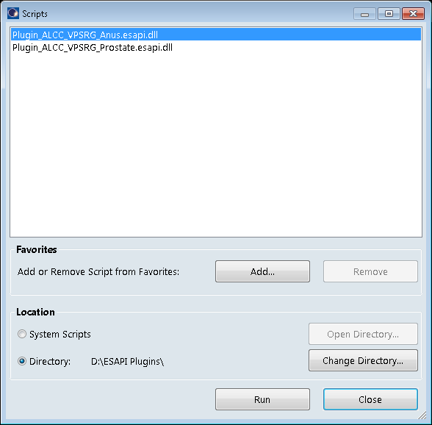
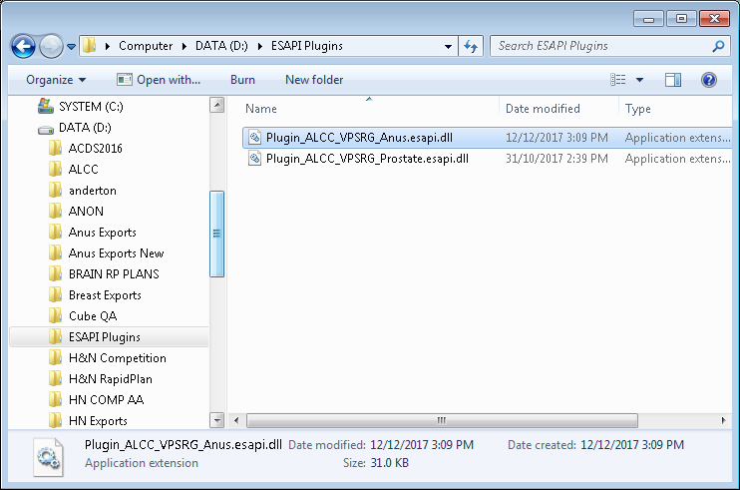
Save Script in Correct Location
Copy and Paste the Anus.esapi .dll script into a directory accessible from the Eclipse WS (can be a local or network dir.) and copy the Excel spreadsheet to a convenient location.
ALCC – Flavio Nelli & Phillip Moloney

Slide 4
Some tips before you use the script
Open the plan you wish to export for data collection
Record the following information for each plan (if available) before running the script:
(It may be helpful to type this into the Excel spreadsheet first)
New (fake) ID (optional),
Number of PTV Dose Levels
Intermediate Risk PTV Dose,
Low Risk PTV Dose,
Diagnosis (i.e. C21.1),
Staging (i.e. T2 N3 M0 ),
If Primary Site Only or Primary Site + Pelvic Nodes?
Number of inverse planning OARs created?
Number of manually added optimiser objectives?
Number of hot/cold spot control structures created?
Number of optimiser reruns ? (not including 1st intermediate rerun)
RapidPlan model version if applicable (i.e. 1.2V)
The script is not fully user fault prof. If you choose something wrong, there is not “back” button.
If you choose 3 PTVs, then you have to select 3 PTV structures (auto or manually), the “cancel” button does not apply for PTVs.
For other structures, if you cancel (or hit Ok with empty string) when prompted for structure name, then no structure is chosen.
If you do not remember the exact name, just type any (some) letters of the name (case insensitive) and a list of structures containing the typed string will be presented to choose from, at this stage, no cancel is available!
If the final list of structures selected are not as desired, you have to start all over again.
The script produces 3 files on the C:\temp\[Hospital Id]\[Patient Id]:
A “csv” file (for importing into the workbook) with following name:[Hospital Id]_[Patient Id]_[Plan Id].csv
An “xml” file with the dvh data with the following name: [Hospital Id]_[Patient Id]_[Plan Id].xml
And a “txt” file with the list of selected structures, with the following name: SelectedStructures_[Hospital Id]_[Patient Id]_[Plan Id].txt (for QA)
The script will override the already produced files if run again on the same plan.
Please send Flavio or Phil an e-mail signaling that files have been uploaded ( there is limited capacity on free google drive)
ALCC – Flavio Nelli & Phillip Moloney

Slide 5
Run the Script
Run the Anus.esapi.dll script
ALCC – Flavio Nelli & Phillip Moloney

Slide 6
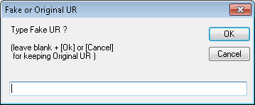
Run the Script
The data collection if fully anonymized: not any patient personal data is recorded. However, due to the very specificity of the collected data, as DVH data from several structures, anyone with access to the database where the original data is stored can easily find the identity of the patient to which the data belongs. If the primary record ID (UR) used does not contains personal data, hiding the primary record ID is not necessary.
If you want to hide the original record ID (UR), just type the new ID you want to replace the original one when prompted.
Please note that if you leave the text field empty and hit [Ok] or if you hit [Cancel] or close the dialog window (clicking [x]), the original record ID will be used.
ALCC – Flavio Nelli & Phillip Moloney

Slide 7
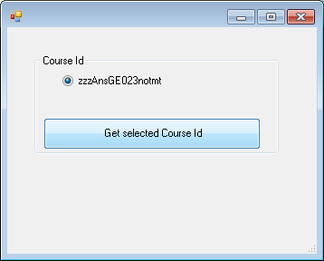
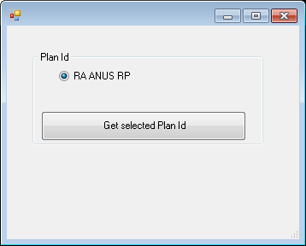
Run the Script
Select the correct Course ID and click ‘Get’
Select the correct Plan ID and click ‘Get’
ALCC – Flavio Nelli & Phillip Moloney

Slide 8
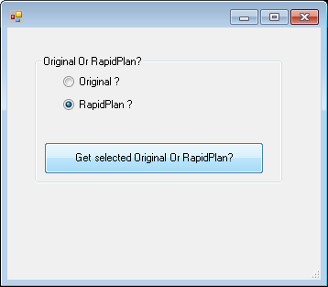
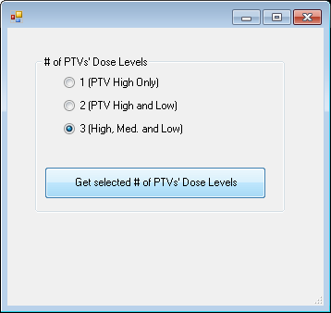
Run the Script
Choose Plan Type and click ‘Get’
Select the # PTV Dose Levels and click ‘Get’
ALCC – Flavio Nelli & Phillip Moloney

Slide 9
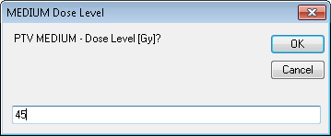
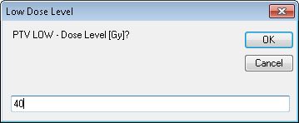
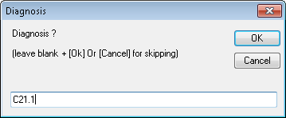
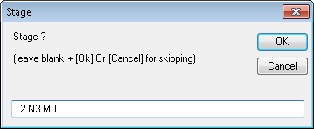
Run the Script
Enter Intermediate PTV Value and click ‘OK’
Enter Low Risk PTV Value and click ‘OK’
Enter Diagnosis and click ‘OK’
Enter Staging and click ‘OK’
ALCC – Flavio Nelli & Phillip Moloney

Slide 10
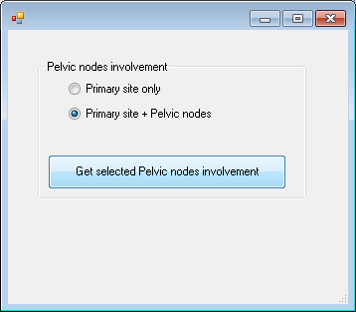
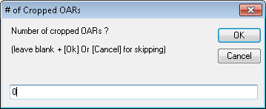
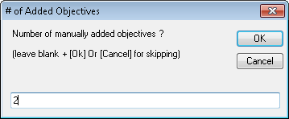
Run the Script
Indicate Node Involvement? and click ‘Get’
Enter # Inverse OAR Structures used
to create this plan and click ‘Ok’
Enter # Manually Added Objectives
used to create this plan and click ‘Ok’
ALCC – Flavio Nelli & Phillip Moloney

Slide 11
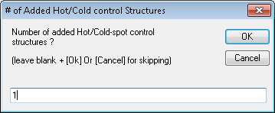
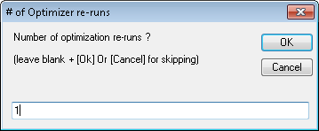
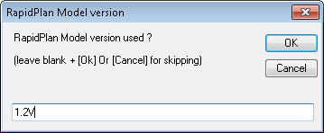
Run the Script
Enter the # of added hot /cold spot control
structures used to create this plan
and click ‘Ok’
Enter the # of optimiser reruns used to
create this plan and click ‘Ok’
Enter the RapidPlan model version used to
create this plan and click ‘Ok’
- Click cancel for non RapidPlan plans
ALCC – Flavio Nelli & Phillip Moloney

Slide 12
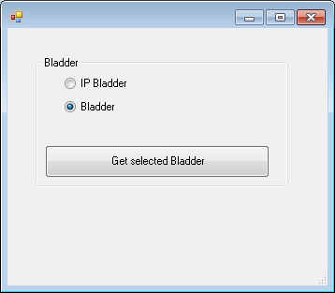
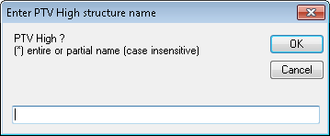
Run the Script
The script will search for the desired structures, first by code and then by name. If more than 1 structure is found, the script will present a list for choosing from.
If not any structure is found, the script will prompt for user to enter the name of the required structure: A list of structures containing the text (case insensitive) will be presented to choose from.
In case the structure is not present, leaving the text field empty and pressing [Ok], or pressing [Cancel] will skip this structure (PTVs cannot be skipped).
ALCC – Flavio Nelli & Phillip Moloney

Slide 13
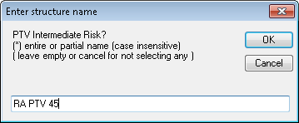
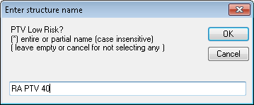
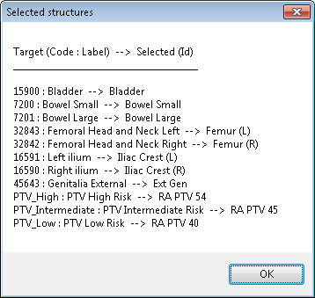
Run the Script
If the PTVs do not have structure codes
assigned the script will not automatically find it. You will need to manually enter the name here
Repeat for Low Risk PTV if required
Confirm that all structures have been matched
correctly and Click ‘OK’
ALCC – Flavio Nelli & Phillip Moloney

Slide 14
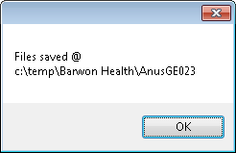
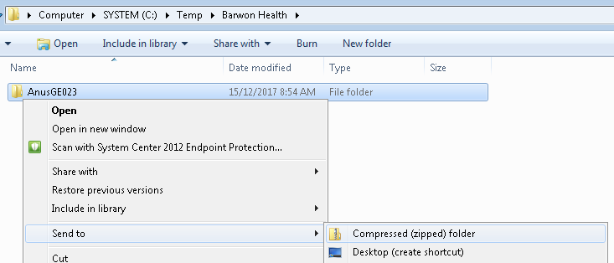
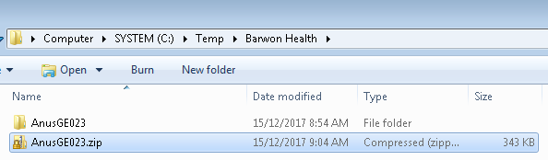
Zip the Export Folder
Zip the patient folder that gets created at:
C:\temp\[Hospital Id]\[Patient id]
ALCC – Flavio Nelli & Phillip Moloney

Slide 15
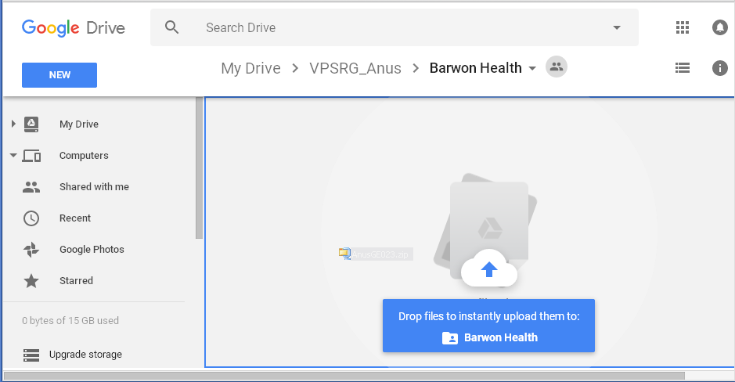
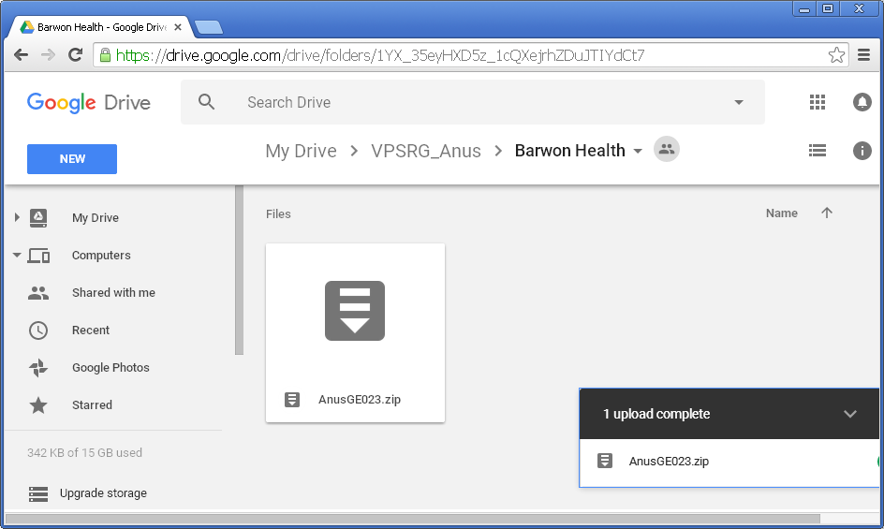
Upload Zipped File to Google Drive
Upload the Zipped Folder here:
https://drive.google.com/drive/folders/1aagv9ObEUAqSC6XxKZIKhwJ2_wzOGFbj?usp=sharing
Those with a google account can sign into the google drive and upload the zipped folder.
Those without a google account can sign-in using VPSRPG
(password R....P... the thing we use for predicting DVHs)
Please, create a folder for your Hospital [Hospital Id] and put all your patients there.
ALCC – Flavio Nelli & Phillip Moloney

Slide 16
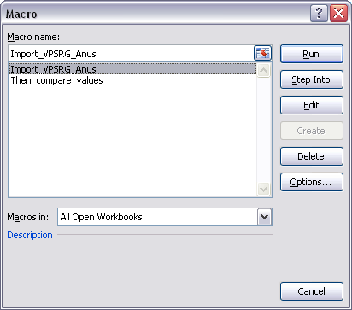
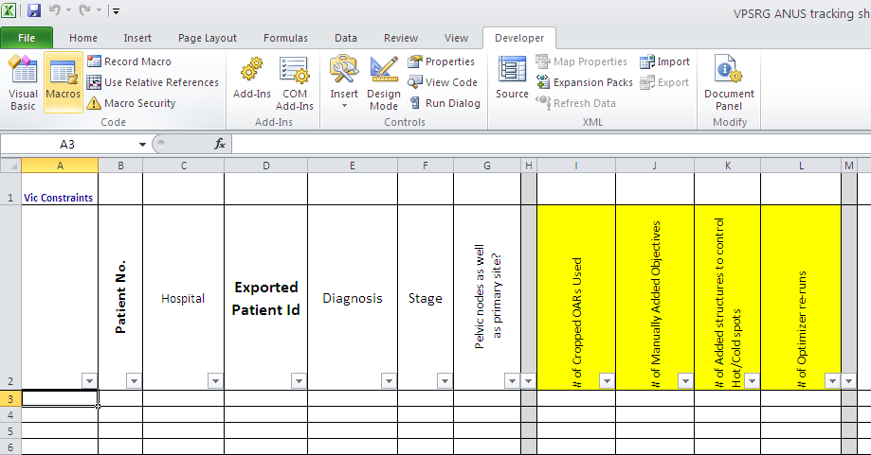
Import the data to the Spreadsheet
Open the VPSRG ANUS tracking sheet:
Select the row you want to populate with extracted data and run the macro, via the Developer Tab
ALCC – Flavio Nelli & Phillip Moloney

Slide 17
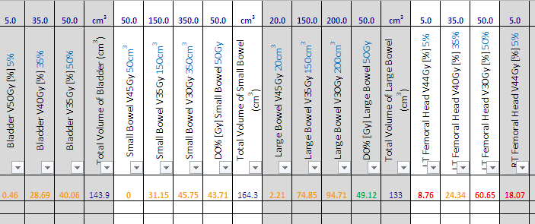
Import the data to the Spreadsheet
Next run the compare values Macro to colour code the data in the table
ALCC – Flavio Nelli & Phillip Moloney

Slide 18
Import the data to the Spreadsheet
The End
ALCC – Flavio Nelli & Phillip Moloney

